Slide 1

Department of Computer Engineering
Number System
1

Slide 2
Points covered
Department of Computer Engineering
Digital electronics
Number systems – binary, octal, decimal and hexadecimal
Number conversions
2

Slide 3
Department Vision & Mission
Department of Computer Engineering
Vision
Achieve academic excellence through education in computing, to create intellectual manpower to explore professional, higher educational and social opportunities.
Mission
To impart learning by educating students with conceptual knowledge and hands on practices using modern tools, FOSS technologies and competency skills there by igniting the young minds for innovative thinking, professional expertise and research.
3

Slide 4
Digital Electronics
Today we see modern digital computers, communication systems, digital display systems, calculator, internet , email etc.
One of the main causes of revolution is integrated circuit (IC).
The operation of digital computers, communication systems and many other systems possible based on the principles of digital techniques and these systems are referred as digital systems.
Digital electronics involves the study of digital systems and basically digital signals.

Slide 5
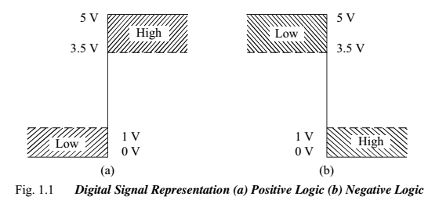
Digital Electronics
Digital signal is represented as LOW level or HIGH level. LOW means binary 0 and HIGH means binary 1.
A binary digit (0 or 1) is referred as bit.
Source : R. P. Jain Book

Slide 6
Why there is widespread use of digital techniques/electronics?
Devices operates in only two states ON (1) and OFF (0) resulting in simple operations
There are few basic operations in digital circuits – easy to understand
Digital techniques require the use of Boolean algebras – simple
A large number of ICs available for performing various operations
(ICs are reliable, accurate, small in size, speed of operation is high)
Effect of fluctuations in the characteristics of component, aging of components, temperature and noise is very small in digital circuits.
Digital circuits have capability of memory.

Slide 7
Number System
Department of Computer Engineering
In Digital Electronics, number system is used for representing the information.
The number system has different bases.
Decimal, Binary, Octal, Hexadecimal.
Base or radix – total number of digits used in the number system.
e.g. Number representing digit from 0 to 9 – base is 10
Number representing digit from 0 to 1 – base is 2

Slide 8
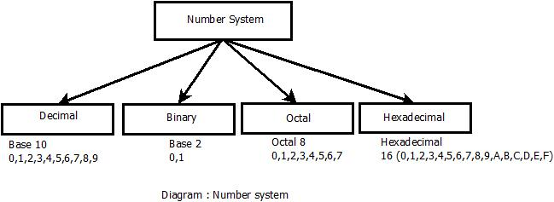
Number System
Department of Computer Engineering
Group of eight bits called as byte. (11001001)₂
Groups of four bits are called a nibble. (1101) ₂

Slide 9
Department of Computer Engineering
Number Conversions : Decimal to other number system
Decimal to Binary
e.g. (29)₁₀
Step | Operation | Result | Remainder
1 | 29/2 | 14 | 1
2 | 14/2 | 7 | 0
3 | 7/2 | 3 | 1
4 | 3/2 | 1 | 1
5 | 1/2 | 0 | 1
Remainders
In reverse
(29)₁₀ = (11101)₂

Slide 10
Department of Computer Engineering
Number Conversions : Decimal to other number system
Decimal to Octal
e.g. (29)₁₀ ₌(35)₈
Step | Operation | Result | Remainder
1 | 29/8 | 3 | 5
2 | 3/8 | 0 | 3
Remainders
In reverse
Decimal to Hexadecimal
e.g. (29)₁₀ = (1D)₁₆
Step | Operation | Result | Remainder
1 | 29/16 | 1 | 13
2 | 1/16 | 0 | 1
Remainders
In reverse

Slide 11




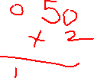
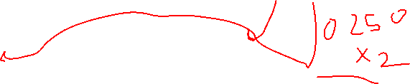

Department of Computer Engineering
Number Conversion: Fraction from Decimal to other number system
e.g. (0.625)₁₀ = (0.a-1 a-2 a-3 )₂ = (0.101)₂
Step | Operation | Fraction | Coefficient
1 | 0.625 x 2 | 1 + 0.25 | a₋₁ = 1
2 | 0.250 x 2 | 0 + 0.50 | a₋₂ = 0
3 | 0.500 x 2 | 1 + 0 | a₋₃ = 1
Decimal to Octal
e.g. (0.3125)₁₀ = (0.24)₈
Step | Operation | Fraction | Coefficient
1 | 0.3125 x 8 | 2 + 0.5000 | a₋₁ = 2
2 | 0.5000 x 8 | 4 + 0.0000 | a₋₂ = 4

Slide 12


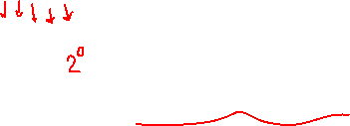


Department of Computer Engineering
Number Conversions: Binary to other number system
Binary to Decimal
e.g. (11101)₂
= 1 x 2⁴ + 1 x 2³ + 1 x 2² + 0 x 2¹ +1 x 2⁰
= 16 +8 +4 + 0 + 1
= (29)₁₀
Binary to Octal
e.g. (11101)₂ ₌ (011 101)₈ = (35)₈
Binary to Hexadecimal
e.g. (11101)₂ ₌ (0001 1101)₁₆ = (1D)₁₆

Slide 13





Department of Computer Engineering
Number Conversions: Octal to other number system
Octal to Decimal
e.g. (35)₈
= 3 x 8¹ + 5 x 8⁰
= 24 + 5
= (29)₁₀
Octal to Binary
e.g. (35)₈ ₌ (011 101)₂ = (11101)₂
Octal to Hexadecimal
e.g. (35)₈ ₌ (011 101)₁₆ = (0001 1101)₁₆ ₌(1D)₁₆

Slide 14
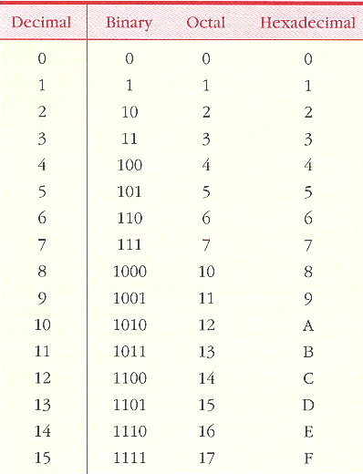
Department of Computer Engineering
Putting it all together : Decimal, Binary, Octal, Hexadecimal

Slide 15
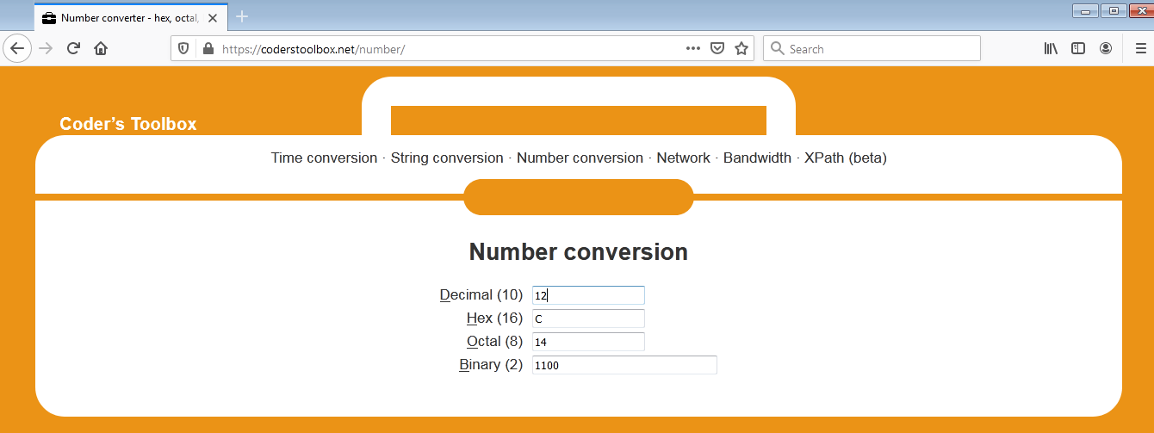
https://coderstoolbox.net/number/
Department of Computer Engineering

Slide 16
Summary
Department of Computer Engineering
Number system : Decimal, Binary, Octal, Hexadecimal
Number Conversions

Slide 17
Department of Computer Engineering
Thank you

